Slide 1
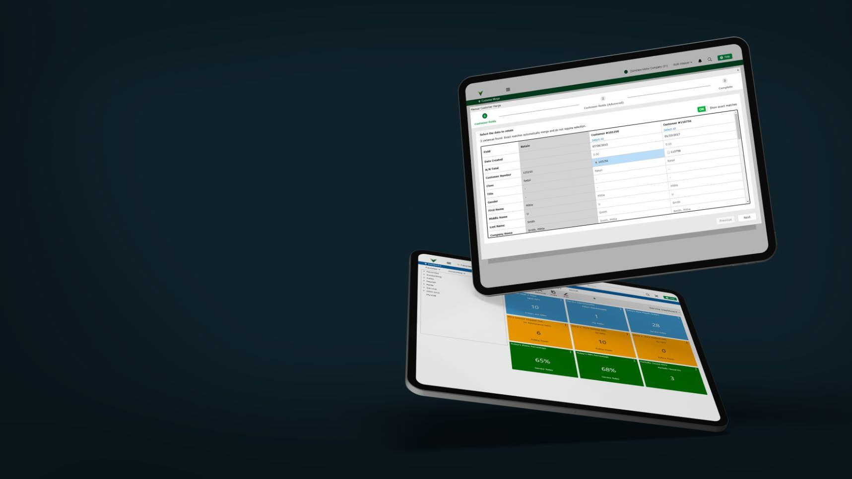



Ten Ways to Optimize Software Investment
Sharon Kitzman
President of Dominion DMS
DominionDMS.com

Slide 2

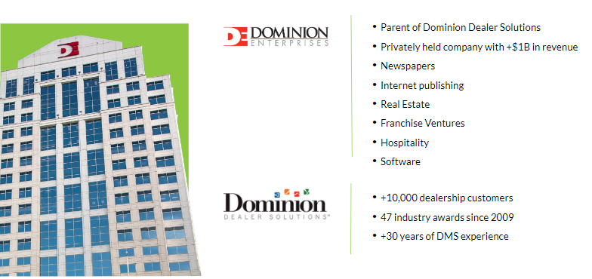

Dominion DMS
Company Confidential and Proprietary | Copyright © Dominion DMS, LLC
DominionDMS.com

Slide 3
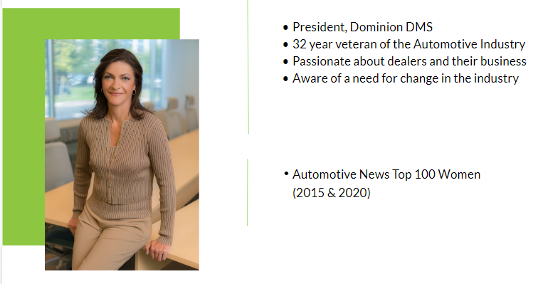
Sharon Kitzman
Company Confidential and Proprietary | Copyright © Dominion DMS, LLC
DominionDMS.com

Slide 4

Mission, Vision & Core Values
Mission
Core Values
Partnering with automotive dealers and vendors in an ever-evolving landscape, offering modern solutions that deliver a superior consumer experience to drive loyalty and profitable growth
Accountability | Do it. Own it. Drive it.
Our Team | Grow Together
Dedication | Champion Excellence
Innovation | Revolutionizing Ingenuity
Community | Impactful Outreach
Vision
To be the most recognized and recommended automotive dealer
and vendor solution. Redefining partner with every interaction
Company Confidential and Proprietary | Copyright © Dominion DMS, LLC
DominionDMS.com

Slide 5

10 Ways to Optimize Your Software

Slide 6
How much software do you have?
Dealerslink • OptionSoft Technologies: Deep Dive • PayMaple • MenuMetric • Edifice Automotive Marketing • Flick Fusion • OptionSoft Technologies: Service Drive • IPS: ScanIt Vehicles • DealerTrend: CarDealerPress • Paymentflo: Checkflo • Crypton Mobile: CryptoSIGN • Dealer Venom • AIB: TitleDirect • Software Techniques • Total Customer Connect: Sales Marketing • Total Customer Connect: MPI • Dealerslink: Inventory Appraisal Tool • iTapMenu • AutoService AI • Traffic Control: Traffic 360 CRM • Affinitiv: XRM • REPAY • Total Customer Connect: Texting • Opus VTR • Digital Technology, Inc. • AutoSweet • AutoAlert: CXM • Carmen: Service Concierge • Elite EXTRA • Total Customer Connect: Mobile Bill Pay • SimpSocial • Auto Pro Solutions: Scheduling / Shop Loading • Total Customer Connect: Menu Builder • DealerPeak • AutoAp: Dynamic Recall Management • Dealer Services Network: DocuPro • Customer Research • Demand Local • Total Customer Connect: BDC • Macrosmith • CarNow: Real-Time Retail • Prospay • DealerFunnel • Dealership For Life • CreditMiner • DealerJazz • BlinkAi • OptionSoft Technologies: Client Connect • 360-Five Digital: 360-Five Payments • CMT Scanner • SmartPay Solutions • Total Customer Connect: Service Connect • DealerVision.com • Auto Pro Solutions: Walk Around / MPI • Total Customer Connect: MPI • Xcel Media Group • Cion Digital • Total Customer Connect: Service Marketing • Dealer Addendums • IPS: ScanIt Parts • Fixed Performance • Preferred Payments • Calendar Systems • Workflow Solutions 360 • Rome Technologies • Credit Bureau Connection • Conversica: Revenue Digital Assistants • DealerOps • Performance Loyalty Group • Maestro Personal Assistant • Autodex: CRM • SMART Payment Plan • Traxtion • Total Customer Connect: Service Lane Check In • Covideo Dealer Services • Auto Pro Solutions: Service Menu • DriveCentric • Astute RM: SaaS CRM • Clicktunity • Total Customer Connect: Appointment Scheduler • Auto Pro Solutions: Texting • OptionSoft Technologies: OmniMenu • Momentum CRM • TrueSpot: TrueRecon • TrueSpot: Lot Management 360 • CloudX • ScanSolutions: Parts Wizard • EFG Companies • ProMax: CRM • OptionSoft Technologies: GoGoCar • KEYper Systems • Pave • iService Auto: iService Product Suite • Velocity Automotive: VelocityEngage • Certified Dealer's Process • Dynatron Software: VFI • Agility Credit: Credit Bureau • ShipYourCarNow • AutoVision • Scan123 • ScanSolutions: Vehicle Wizard • DriveRightData
Dealer Tech 2021 Report
16
&
$30K
per month
Company Confidential and Proprietary | Copyright © Dominion DMS, LLC
DominionDMS.com

Slide 7
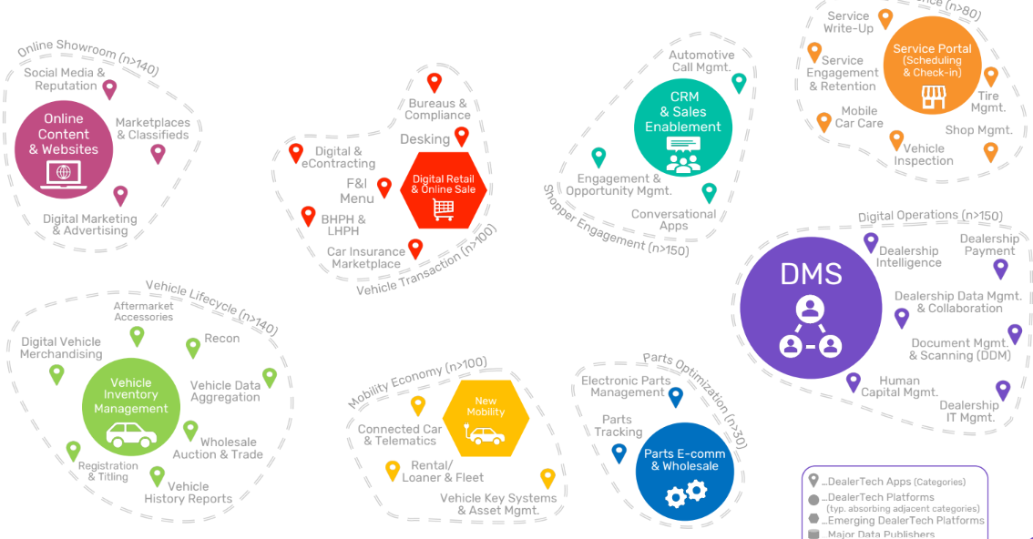
Automotive Ecosystem
Dealer Tech 2021 Report
16
&
$30K
per month
Company Confidential and Proprietary | Copyright © Dominion DMS, LLC
DominionDMS.com

Slide 8

#1 – Manage Contract Terms
The Answer
Short Terms = Flexibility
Technology Obsolescence
2013 Forbes – Web-base Apps 3-5 year shelf life
2023 Google – 18-month inception to sunset cycle
Innovation | Latest and Greatest
Industry | Adapt to the Market
Consolidation | Business Opportunity
Financed Asset History
1992 - 6-figure on-premise server investment
2002 – transition to hosted server environments
2023 – Fractional space & Elastic Pools
Company Confidential and Proprietary | Copyright © Dominion DMS, LLC
DominionDMS.com

Slide 9
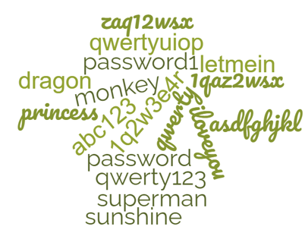
#2 – User Log-ins
The Answer
Single Sign On
Example - Sales Manager
DMS
CRM
Desking
Inventory
Digital Retailing
Credit
Key Tracking
Analytics/Reporting
eContracting
Equity Mining
Registration & Titling
Vehicle Appraisal
Vehicle Scanning
Website (admin)
Security | Passwords- & MFA
Usage | Top of mind
Browser | Launch & Recovery
Integration | Efficient
Onboarding | Less to learn
Company Confidential and Proprietary | Copyright © Dominion DMS, LLC
DominionDMS.com

Slide 10
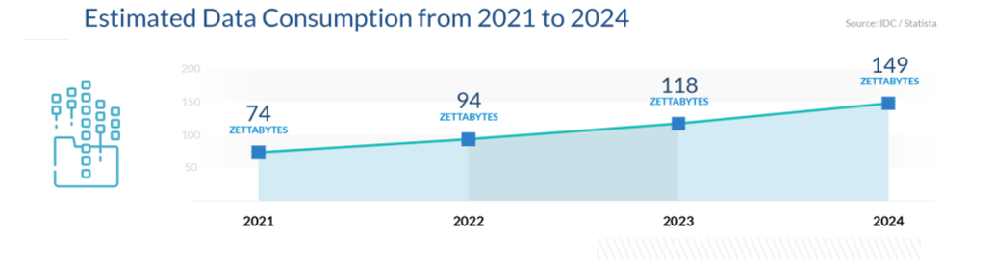
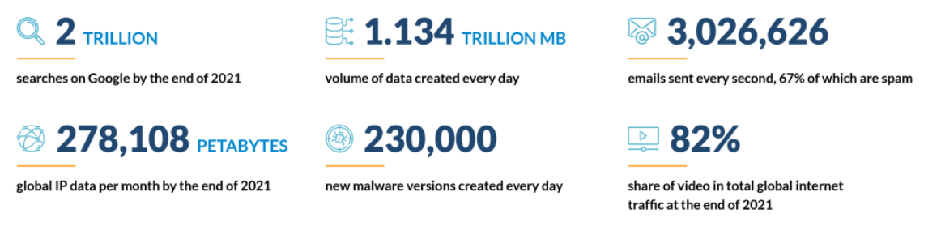
#3 – Certified Secure
2021 Data Statistics – Source Cisco
Company Confidential and Proprietary | Copyright © Dominion DMS, LLC
DominionDMS.com

Slide 11
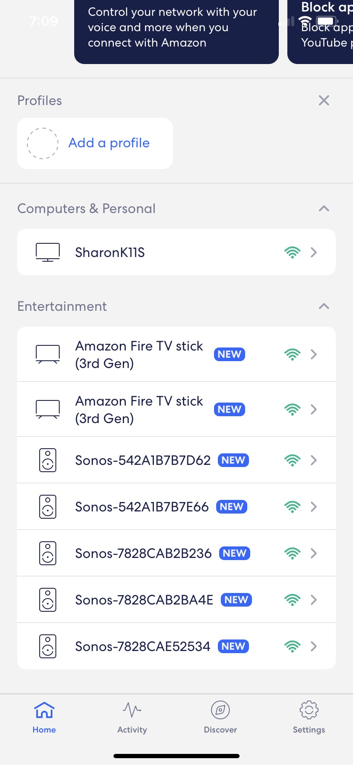
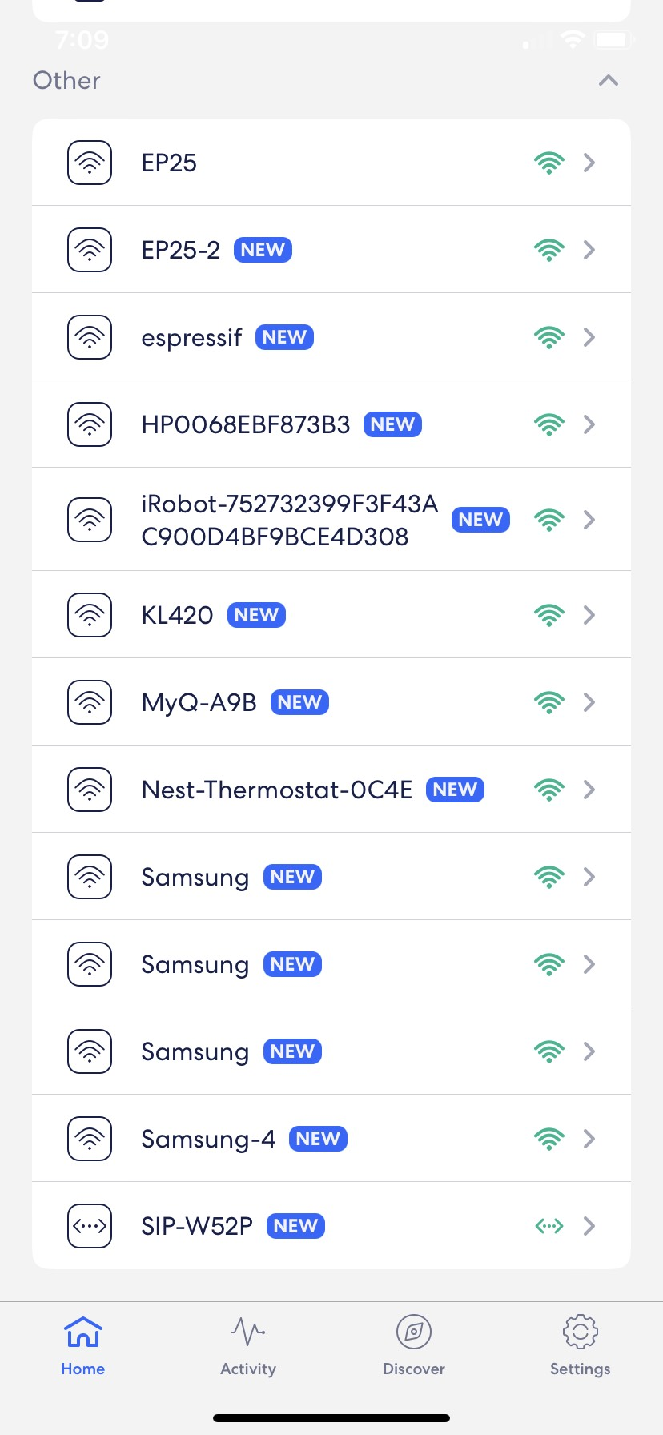
#3 – Certified Secure
Sharon’s wi-fi
I was shocked to see the number of devices connected to my router.
What is connected to your dealership network?
Company Confidential and Proprietary | Copyright © Dominion DMS, LLC
DominionDMS.com

Slide 12
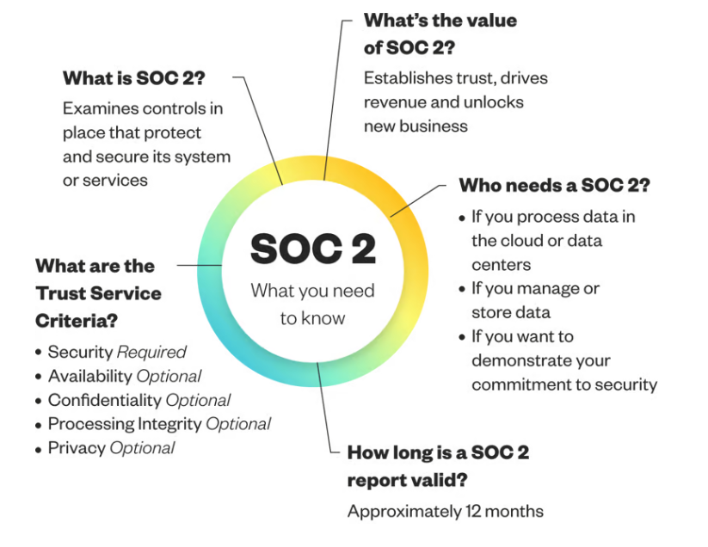
#3 – Certified Secure
Ensure your software solutions are SOC 2 Certified
The Answer
SOC Certified Solutions
Protocols | Controls & Services
Value | Trust
Security | Required
Cloud | Required
Frequency | Annual
Company Confidential and Proprietary | Copyright © Dominion DMS, LLC
DominionDMS.com

Slide 13
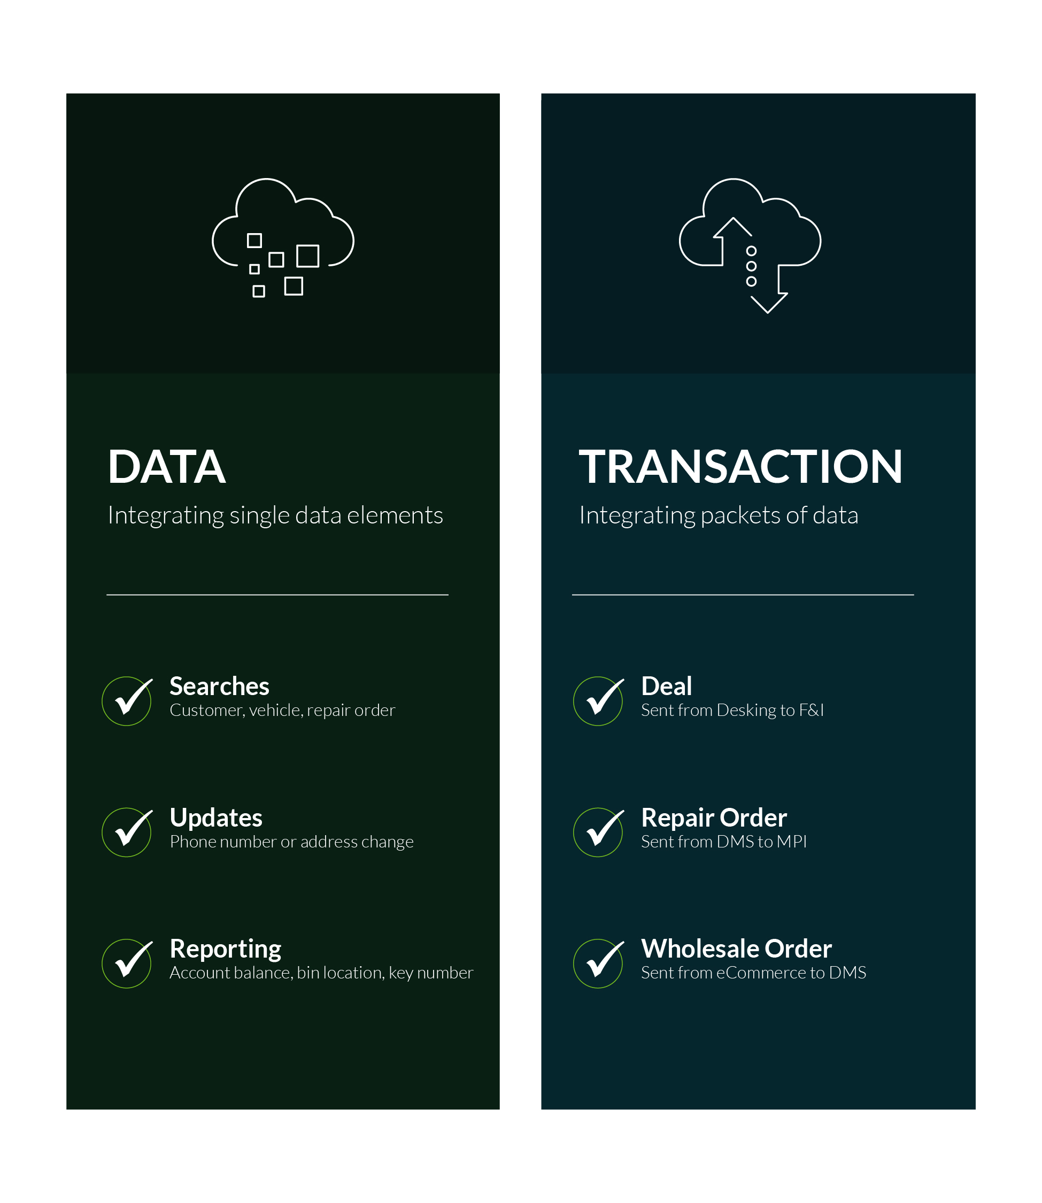
#4 – Data vs. Transaction
Is your software ecosystem integrated at a data or transaction level?
The Answer
As much transaction integration as possible
Department of Labor Report 2021 – Time wasted re-entering existing data.
39%
Company Confidential and Proprietary | Copyright © Dominion DMS, LLC
DominionDMS.com

Slide 14
#5 – Real Time
Are your transactions throttled?
The Answer
Cloud Native
Throttled
Real-Time
Speed | Eliminates bottlenecks
Cost | Pay for what you use
Scale | Up or down in real-time
Reliability | High-Availability
Security | By Design
15 Minutes
<Second
Company Confidential and Proprietary | Copyright © Dominion DMS, LLC
DominionDMS.com

Slide 15
#6 – Outside of Ecosystem
Solutions for your business outside of Automotive!
The Answer
Truly Open Partners
2021 - ~200,000,000 public APIs
2024 – expected >400,000,000 public APIs
Source DevOps.com
Logistics | Business | A.I.
Speed | Insights | Innovation
Status Costs Routing Weather | Analytics Banking Productivity Professional | Social Media A/R Coms Recalls
Expect More | Work Smarter | Adopt Technology
Company Confidential and Proprietary | Copyright © Dominion DMS, LLC
DominionDMS.com

Slide 16
#7 – Partnered for You
Will your foundation solutions support partnerships that you need; OEM, State, and Market Driven?
The Answer
Best in Class
Foundation Software
OEM | CSI Requirements
OEM | Service Retention
State | Taxes and Fees
State | Consumer Protection
DMS
CRM
Foundation Focus
Integration with a broad market
Acquisition of new entrants
Development of layered apps
Company Confidential and Proprietary | Copyright © Dominion DMS, LLC
DominionDMS.com

Slide 17
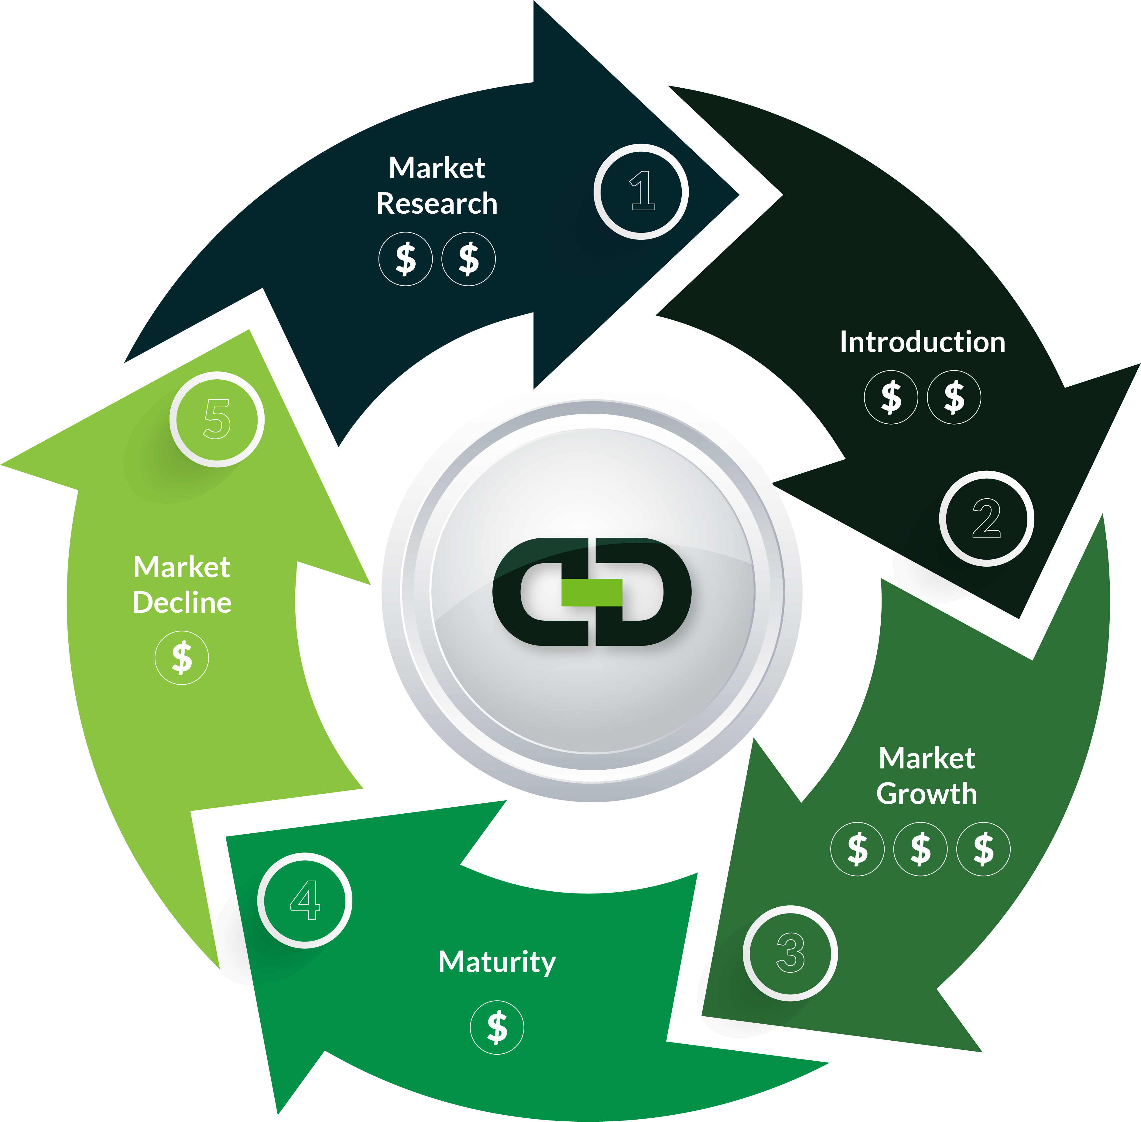
#8 – Ongoing Investment
The Answer
Align Innovation to Business Growth
Are you invested in solutions at the adoption curve's beginning, middle, or end?
Introduction | Digital Retailing
Growth | Parts eCommerce
Mature | Accounting
Decline | Look towards Growth
Company Confidential and Proprietary | Copyright © Dominion DMS, LLC
DominionDMS.com

Slide 18
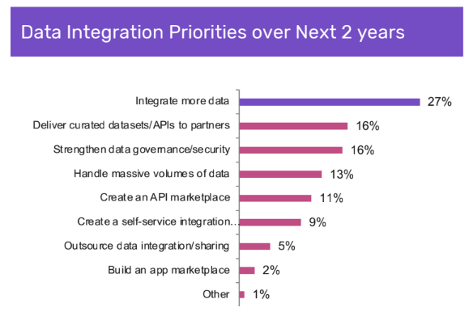
#9 – Better Integrated with DMS
DMS providers, as a foundation software, need to lead the integration effort for your dealership
The Answer
Modern, Open and Secure
Partner | More data
Partner | Secure
Partner | Efficient workflow
Partner | Dealer focus
Partner | Invest
Source: Dealer Tech 2021
Company Confidential and Proprietary | Copyright © Dominion DMS, LLC
DominionDMS.com

Slide 19
#10 – Regularly Assessed
Subscription services. Do you still need them?
The Answer
Quarterly audits
2022 Dealer’s Surveyed
Dealer Tech 2021
16
&
$25K
12
believed
&
18
Actual
Usage | Is it used?
Term | Can I cancel it?
Cost | Am I getting value?
Certification | Must I have it?
Requested | Who wanted it? Are they still here?
Company Confidential and Proprietary | Copyright © Dominion DMS, LLC
DominionDMS.com

Slide 20
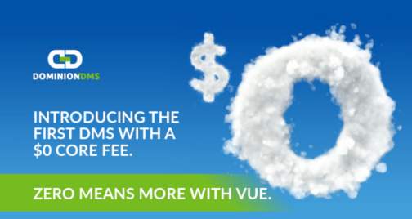
In Summary
Manage Contract Terms
Look for ways to minimize user logins
Ensure your software is Certified and Secure
Integrate Transactions versus Data
Integrate real-time versus batch sweeps
Look for opportunities outside of automotive
Partner versus vendor
Ongoing investment
Better DMS integration
Regularly Assess
Company Confidential and Proprietary | Copyright © Dominion DMS, LLC
DominionDMS.com
Notes:
First call resolution drop
First call resolution drop during February due to a software outage early in the Month and a repair order detail issue that took a few weeks to be resolved.
Up Time - Apology to Dev Ops Team

Slide 21
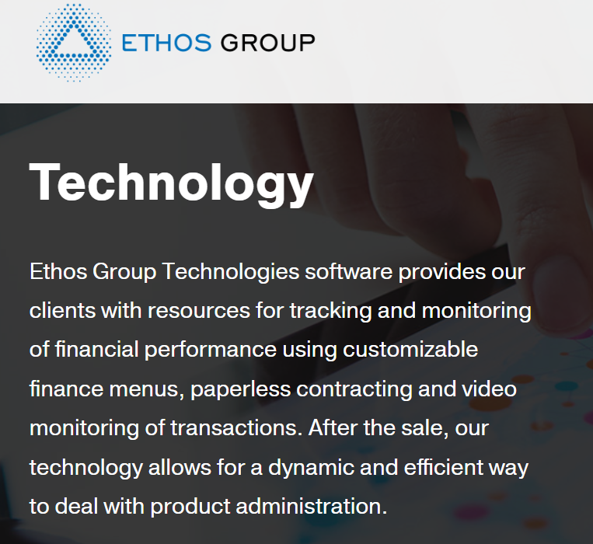
Ethos
Company Confidential and Proprietary | Copyright © Dominion DMS, LLC
DominionDMS.com

Slide 22
Thank you
Company Confidential and Proprietary | Copyright © Dominion DMS, LLC
DominionDMS.com

